Slide 1
scenarios for component Issue joins with NCRS

Slide 2
NCR Data
Query all DISTINCT Component Issues where FM Ref Des = CompIssue Ref Des and where NCR create date >= CompIssue date
Else NCR columns = Null
1
Time →
Want One Row with No NCR info
1st Component Issued
2
Time →
Want One Row with No NCR info
1st Component Issue
NCR creation Date
Fmrefdes <> IssuedCompRefdes
3
Time →
Want One Row with NCR info + one row with no NCR
SN 4024262497
RefDes C503
MfgOrder 000013294949
PN 4200-00
Product 422662
Supplier
1st Component Issued
NCR1 create Date Fmrefdes = IssuedCompRefdes
Rework Component Issue
4
Time →
Want Two Rows with same CompIssue, each having distinct NCR info
SN 4024157004
RefDes SUB
MfgOrder 000013249901
PN 8023
Product 460069
1st Component Issue
NCR creation Date
Fmrefdes = IssuedCompRefdes
NCR creation Date
Fmrefdes = IssuedCompRefdes

Slide 3
NCR Data
Query all DISTINCT Component Issues where FM Ref Des = CompIssue Ref Des and where NCR create date >= CompIssue date
Else NCR columns = Null
5
Want One Row with No NCR info
Time →
6
Time →
Want One Row with NCR info
ModuleSN = 4024671899
RefDes = FT1
MfgOrder = 000013459840
PN = 2260-23
ComponentProduct = 401419
Mar 2023
1st Component Issued
NCR1 create Date Fmrefdes = IssuedCompRefdes
NCR creation Date
Fmrefdes <> IssuedCompRefdes

Slide 4
NCR Data
Query all DISTINCT Component Issues where FM Ref Des = CompIssue Ref Des and where NCR create date >= CompIssue date
Else NCR columns = Null
Want NCR info associated with 1st Component Issue
7
Time →
8A & B
Time →
Want NCR1 info associated with 1st comp issue and refdes
Want NCR2 associated with 2nn comp issue
SN 4024262733
RefDes C301, FRAME
MfgOrder 0000132966070
PN 8023
Product 460069
1st Component Issue
NCR1 create Date Fmrefdes1 = IssuedCompRefdes
NCR2 creation Date
Fmrefdes2 = IssuedCompRefdes
Rework 1st Component Issue
2nd Component Issue
2nd Component 2nd Issue

Slide 5
NCR Data
Query all DISTINCT Component Issues where FM Ref Des = CompIssue Ref Des and where NCR create date >= CompIssue date
Else NCR columns = Null
9
Time →
Want 1st NCR info associated with 1st issued component.
Want 2nd NCR counted against 2nd issued component.
SN 4024143114
Ref Des C412
MfgOrder 000013244321
PN 8023
1st Component Issue
NCR creation Date
Fmrefdes = IssuedCompRefdes
Rework Component Issue
2nd NCR same Ref Des Creation Date
Fmrefdes = IssuedCompRefdes

Slide 6
NCR Data
Query all DISTINCT Component Issues where FM Ref Des = CompIssue Ref Des and where NCR create date >= CompIssue date
Else NCR columns = Null
11
Time →
SN 4024688970
RefDes C309
MfgOrder 000013473066
PN 2260-23
Comp Product 397761
1st Component Issue
NCR creation Date
Fmrefdes = IssuedCompRefdes
Rework Component Issued
12 (similar to 4 but reworked in between)
Time →
SN ‘4022067915’,
Ref Des F101
MfgOrder 000012485090
PN 4180-21
Comp Product 354480
1st Component Issued
NCR1 creation Date
Fmrefdes = IssuedCompRefdes
Rework Component Issued
NCR2 creation Date
Fmrefdes = IssuedCompRefdes
13
Time →
SN 4024671899
Ref Des FT1
MfgOrder 000013459840
PN 2260-23
Comp Product 401419
1st Component Issue
NCR1 creation Date
Fmrefdes = IssuedCompRefdes
NCR2 creation Date
Fmrefdes <> IssuedCompRefdes

Slide 7
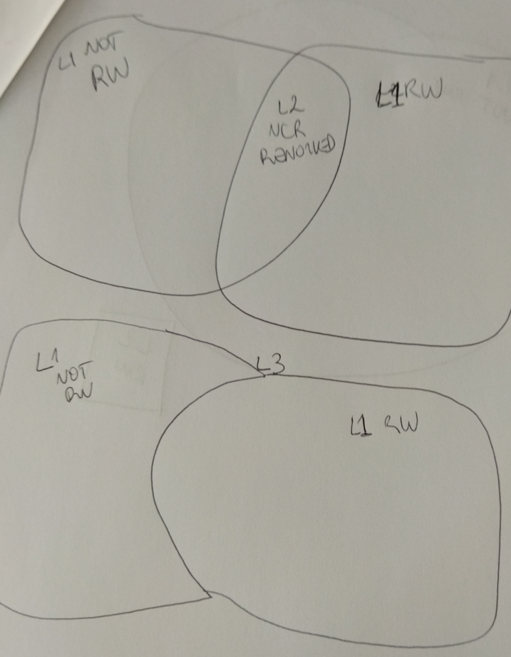
Query all DISTINCT Component Issues where FM Ref Des = CompIssue Ref Des and where NCR create date >= CompIssue date
Else NCR columns = Null
L1b RW
L1a NotRW
L2 = NCR# in L1a with NCR# that exist in L1b
L3 = (L1a – L2) + L1b
removed from L1a any rows where NCR is already in L1b
L4a Modules with NCR’s <> Null
L4a Modules with NCR’s <> Null
L4b Modules with NCR’s = Null
L4b Modules with NCR’s = Null
Modulesn A -> Refdes1 and Ncr1
Modulesn A -> Refdes1 and Ncr2
Modulesn C -> Refdes1 and Ncr3
Modulesn C -> Refdes1 and Ncr4
Modulesn A -> NCR data & CompIssueRefdes = null
Modulesn B -> NCR data &CompIssueRefdes = null
L5 = rows in L4b with moduleSN’s/TxnName/CompIssueRefDes that exist in L4a
L6 = L4a + (L4b – L5)
Modulesn A -> Refdes1 and Ncr1
Modulesn A -> Refdes2 and Ncr2
Modulesn B -> NCR data &CompIssueRefdes = null
Modulesn C -> Refdes1 and Ncr3
Modulesn C -> Refdes1 and Ncr4

Slide 8
Query all DISTINCT Component Issues where FM Ref Des = CompIssue Ref Des and where NCR create date >= CompIssue date
Else NCR columns = Null
L1b RW
L1a NotRW
L2 = NCR# in L1a with NCR# that exist in L1b
L3 = (L1a – L2) + L1b
removed from L1a any rows where NCR is already in L1b
Component A
Component B
Component C
Component D
For each component separately
L4a Modules with NCR’s <> Null
L4a Modules with NCR’s <> Null
L4b Modules with NCR’s = Null
L4b Modules with NCR’s = Null
Modulesn A -> Refdes1 and Ncr1
Modulesn A -> Refdes1 and Ncr2
Modulesn C -> Refdes1 and Ncr3
Modulesn C -> Refdes1 and Ncr4
Modulesn A -> NCR data & CompIssueRefdes = null
Modulesn B -> NCR data &CompIssueRefdes = null
L5 = rows in L4b with moduleSN’s/TxnName/CompIssueRefDes that exist in L4a
L6 = L4a + (L4b – L5)
Modulesn A -> Refdes1 and Ncr1
Modulesn A -> Refdes2 and Ncr2
Modulesn B -> NCR data &CompIssueRefdes = null
Modulesn C -> Refdes1 and Ncr3
Modulesn C -> Refdes1 and Ncr4
Recombine All Components

